Slide 1
Numerical Integration

Slide 2
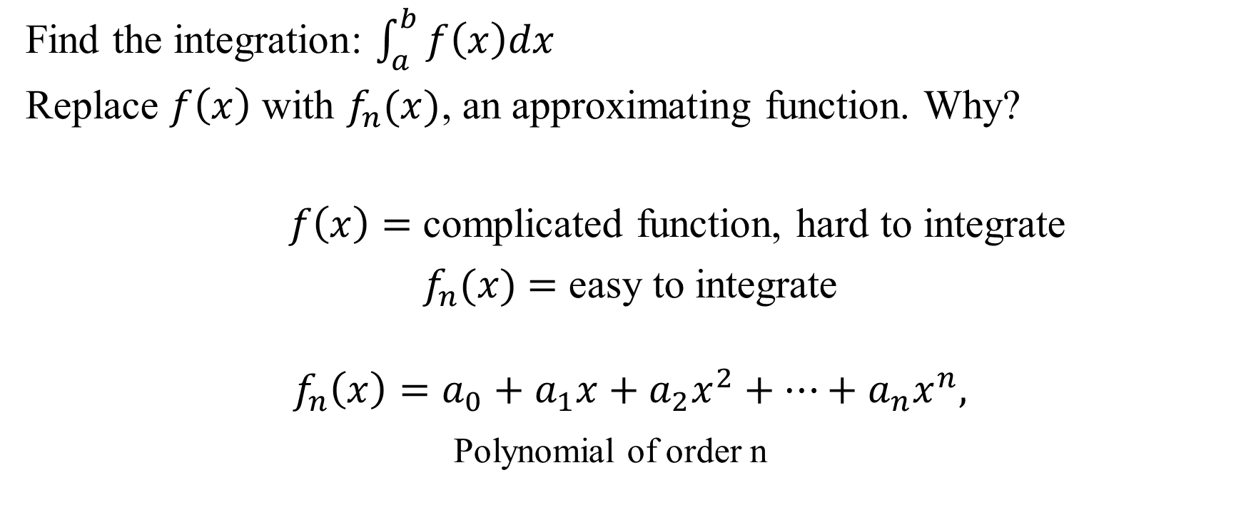
Newton-Cotes Formula
Find the integration: $\int_{a}^{b}{f\left(x\right)dx}$
Replace $f\left(x\right)$ with $f_{n}(x)$, an approximating function. Why?
$f\left(x\right)=$ complicated function, hard to integrate
$f_{n}(x)\text{ =}$ easy to integrate
$$f_{n}\left(x\right)=a_{0}+a_{1}x+a_{2}x^{2}+⋯+a_{n}x^{n},$$
Polynomial of order n

Slide 3
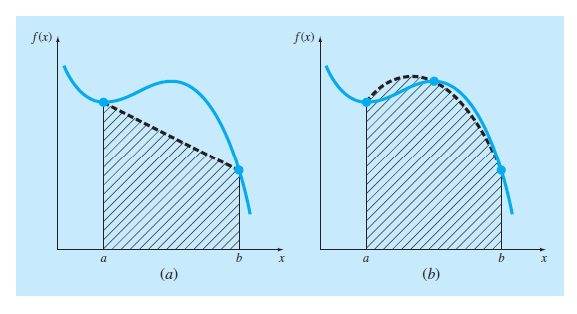

Newton-Cotes Formula

Slide 4

The Trapezoidal Rule
$$I=\int_{a}^{b}{f\left(x\right)dx}≅{\int_{a}^{b}{f_{1}\left(x\right)dx}}_{}$$
First order polynomial (Straight Line)
$$I= \frac{h}{2} [sth]$$
$h=\frac{b−a}{n}$

Slide 5
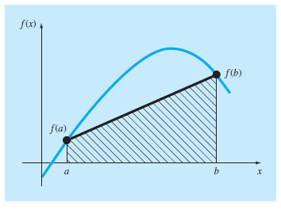

The Trapezoidal Rule: Single Segment
$$I=\left(b−a\right) \frac{f\left(a\right)+f(b)}{2}$$
$$I= \frac{h}{2} [f\left(a\right)+f\left(b\right)]$$
$h=\frac{b−a}{1}$

Slide 6
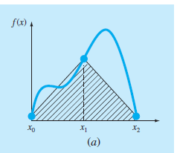
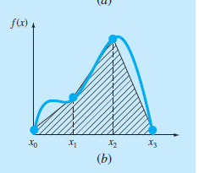
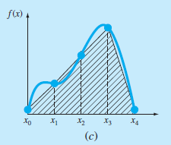
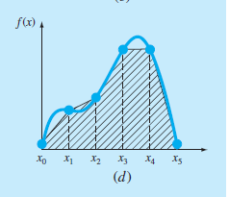

The Trapezoidal Rule: Multi-Segment
$$I= \frac{h}{2} [f\left(x_{0}\right)+2\sum_{i=1}^{n−1}{f(x_{i}})+f\left(x_{n}\right)]$$
$h=\frac{b−a}{n}$

Slide 7


Simpson’s $1/3$ rule
$$I=\int_{a}^{b}{f\left(x\right)dx}≅{\int_{a}^{b}{f_{2}\left(x\right)dx}}_{}$$
Second order polynomial (Parabola)
$$I= \frac{h}{3} [sth]$$
$h=\frac{b−a}{n}$

Slide 8
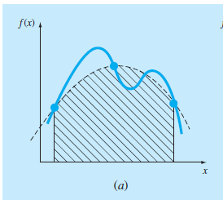


Simpson’s $1/3$ rule: Single Application
$$I= \frac{h}{3} [f\left(x_{0}\right)+4f\left(x_{1}\right)+f\left(x_{2}\right)]$$
$h=\frac{b−a}{2}$

Slide 9
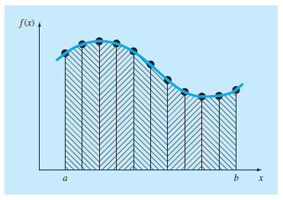


Simpson’s $1/3$ rule: Multi-application
$$I= \frac{h}{3} [f\left(x_{0}\right)+4\sum_{i=1, 3, 5}^{n−1}{f(x_{i}})+2\sum_{j=2, 4, 6}^{n−2}{f(x_{j}})+f\left(x_{n}\right)]$$
$h=\frac{b−a}{n}$
No of segments must be even to imply this method

Slide 10


Simpson’s $3/8$ rule
$$I=\int_{a}^{b}{f\left(x\right)dx}≅{\int_{a}^{b}{f_{3}\left(x\right)dx}}_{}$$
Third order polynomial (Cubic Equation)
$$I= \frac{3h}{8} [sth]$$
$h=\frac{b−a}{n}$

Slide 11
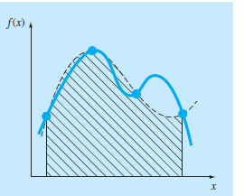


Simpson’s $3/8$ rule: Single Application
$$I= \frac{3h}{8} [f\left(x_{0}\right)+3f\left(x_{1}\right)+3f\left(x_{2}\right)+f\left(x_{3}\right)]$$
$h=\frac{b−a}{3}$

